Slide 1

Price Management

Slide 2
Pricing Hierarchy
Retail Store
Outlet Store
Chain
Chain
$10
$7
Rural Area Stores
Metro Area Stores
Price Chain Zone
Price Chain Zone
$10
$11
Store 1
Store 7
Store 8
Store 4
Store 10
Store 20
$9
AT
POS:
$9
$10
$10
$11
$11
$12

Slide 3

Managing Retail Prices
Multiple Price Chains (banners, formats)
Multiple Zones (Regional or Competitive)
Multiple Price Types (Regular, Flyer, etc.)
Event Based
    Markdown
    Promotion
    Competitive Price Match
    etc.

Slide 4
Zone Pricing
Western Price Zone
Location Zones
Store 1
Store 7
Store 8
Product Zones
Highly Competitive
Price Zone
Beverages
Dog Food
Frozen Treats
Store 1
Store 4
Store 6
Store 16
Store 22
Store 45

Slide 5
Price Inheritance Rules
Retail Store
Chain
$10
Rural Area Stores
Metro Area Stores
Price Chain Zone
Price Chain Zone
$10
$11
Metro Zone is 10% more than chain
Store 8
$12
Store 8 is always set at 25% gross margin

Slide 6
Different Customers, Different Prices
Retail Store
Outlet Store
Chain
Chain
$10
$7
Preferred Shopper
Contractor
Price Book
Price Book
$9.75
$9.50
Retail Store Chain
Retail Store Chain

Slide 7
Why, When & How Much?
01/02/01
$12.00
Regular Retail
08/01/01
09/15/01
$11.00
Back to School
09/03/01
09/10/01
$10.00
Labor Day
$12
$11
$10
$11
$12
The system starts and stops the price based on the effective dates

Slide 8
Pricing Methods
Currency Specific
New Price
Mix / Match
Price Multiple
Deal Groups
Buy x Get y For z
Quantity Based
Rounding Rules

Slide 9
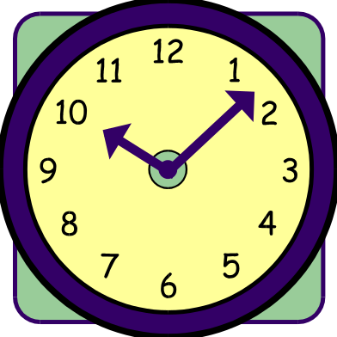
Rules Based Pricing
  Product Selection Rules:
    Inventory Turn (APM)
    Life to Date Sell-Through Percentage (APM)
    Time Based (APM)
    Rate of Sale (APM)
  Price Calculation Rules:
    Competitive Price
    Gross Margin Based on Cost
    Gross Margin Based on Vendor Product Cost
    Auto Price Change
  Review the Suggestions
    The system reviews the products and automatically suggests a new retail
  Accept the changes

Slide 10

Competitive Pricing
Create Shopping Lists
Capture Prices
Suggested Pricing Rules
Individual SKU Inquiries
Multiple Competitor Inquiry in Price Analysis

